Slide 1
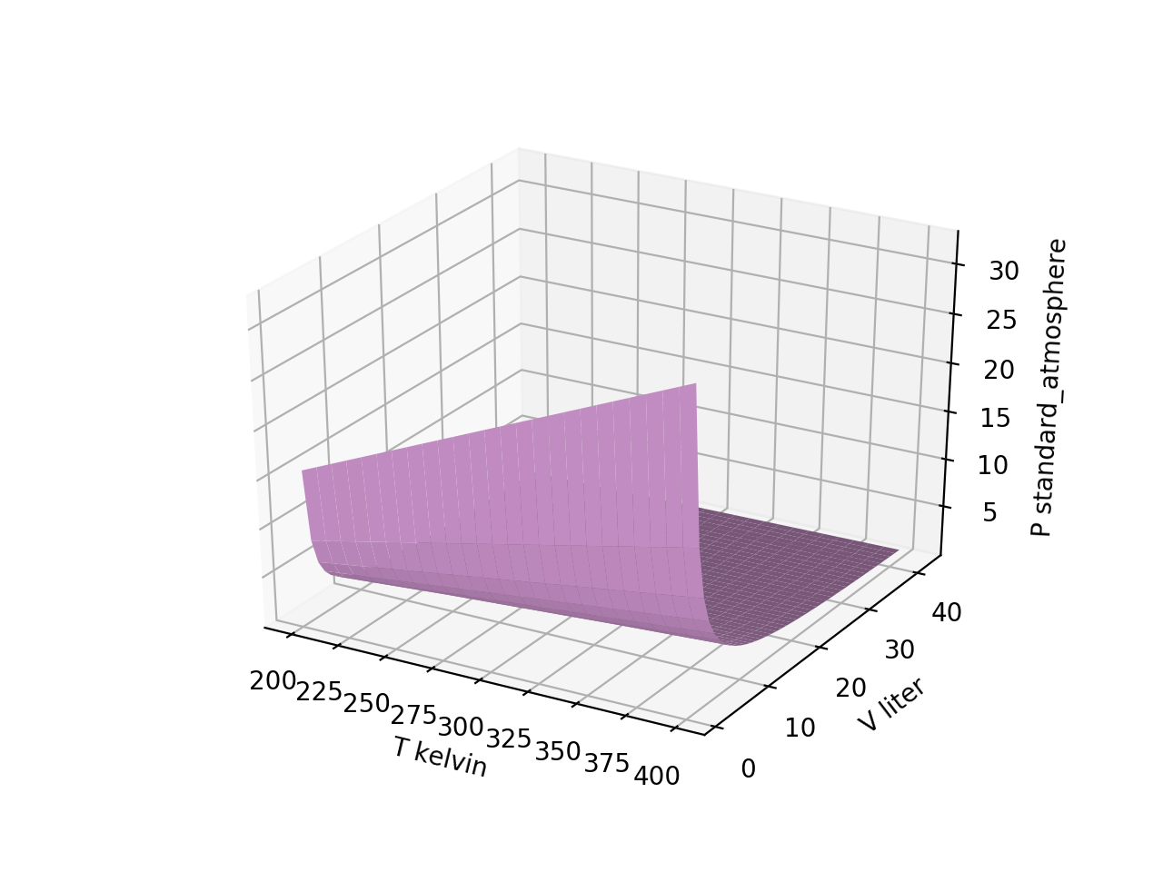
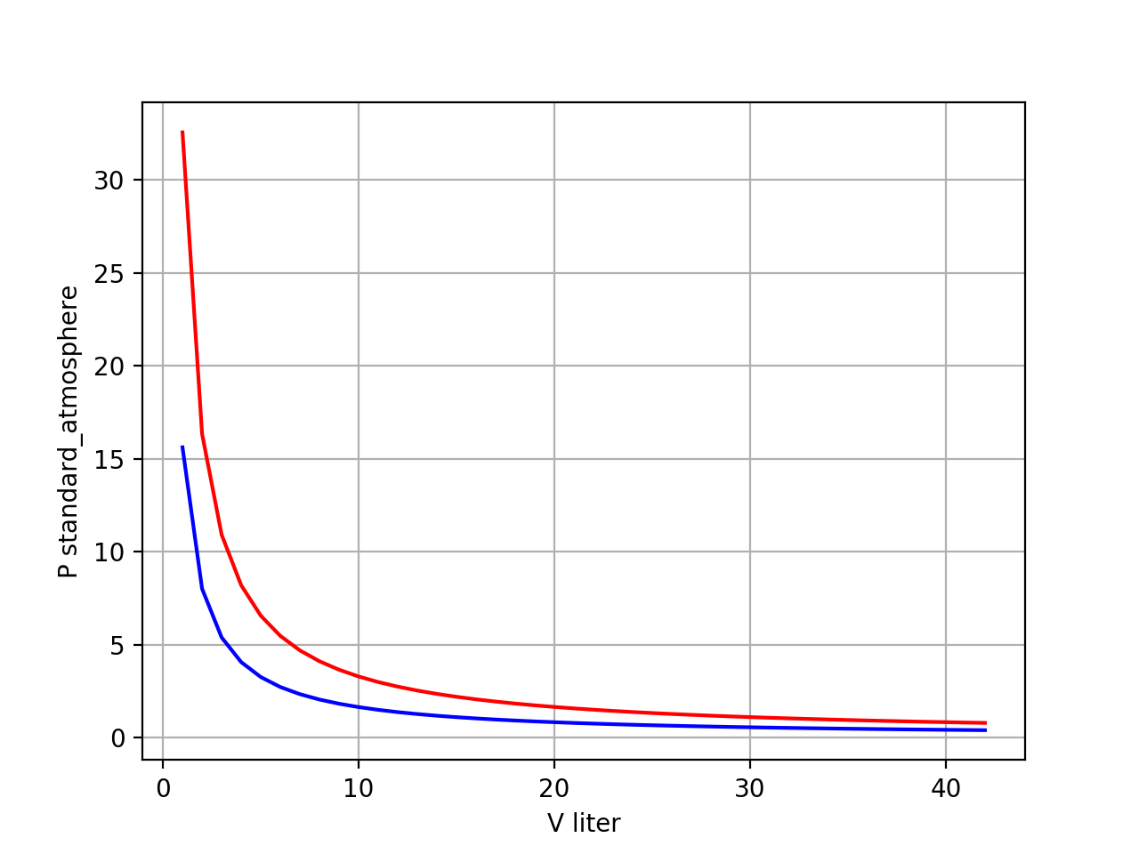
Last time: slices of $P(T,V)$
isotherms

Slide 2
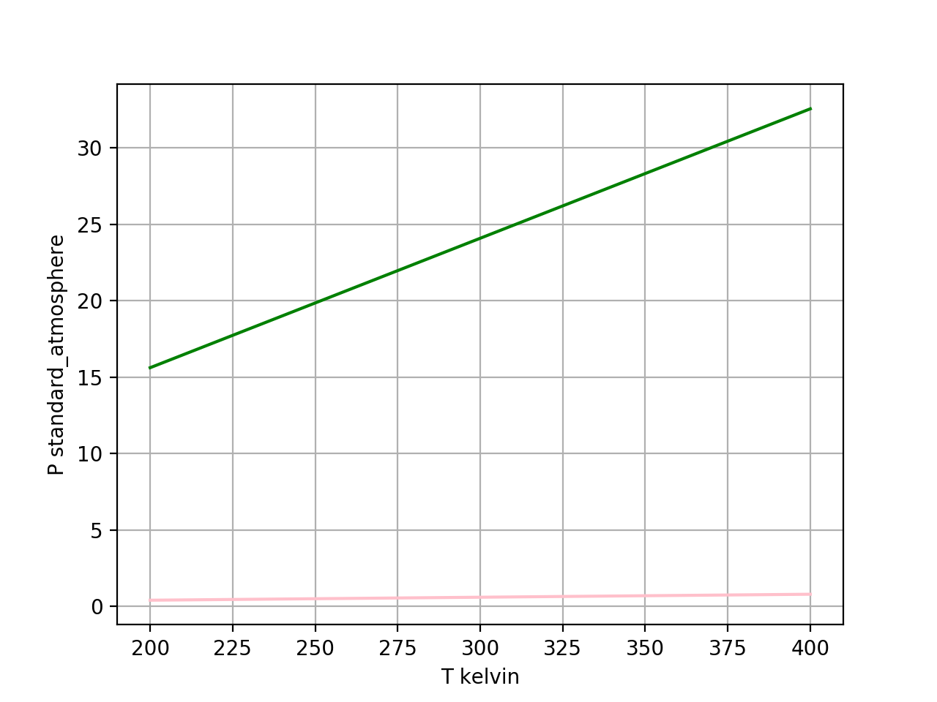
Last time: slices of $P(T,V)$
isochores

Slide 3
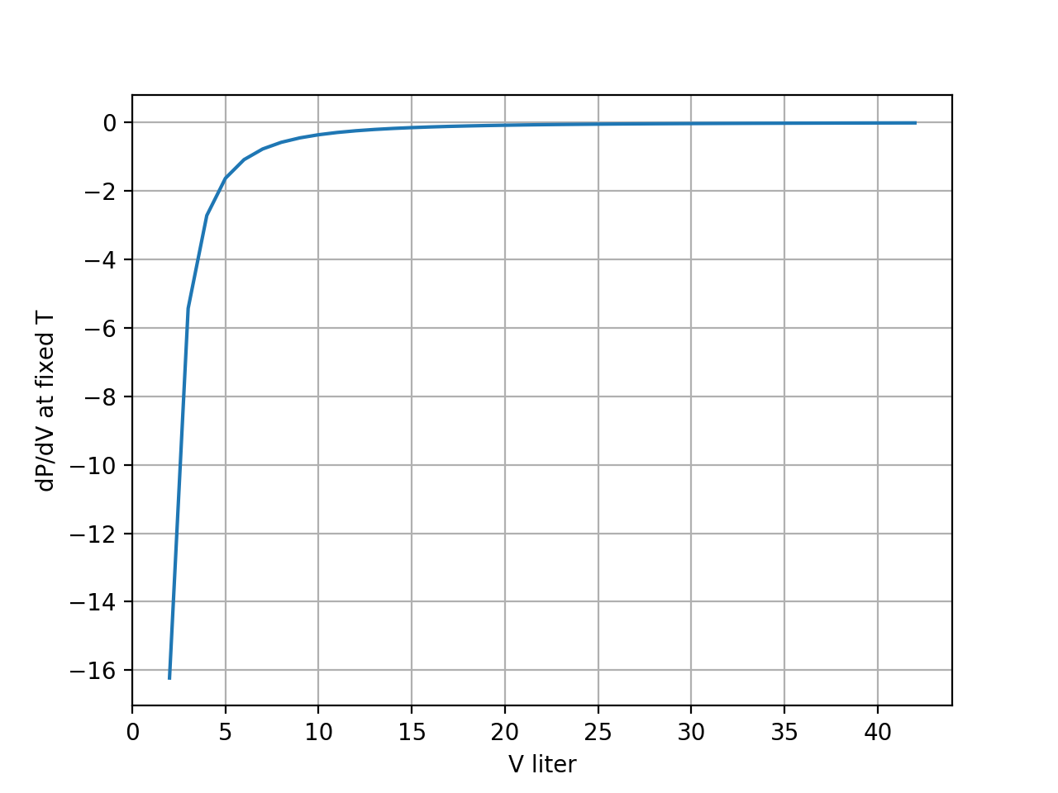
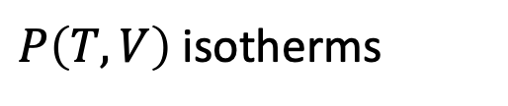
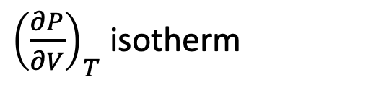
Also ${\left(\frac{∂P}{∂V}\right)}_{T}$ isotherms
$P\left(T,V\right)$isotherms
42 volumes
${\left(\frac{∂P}{∂V}\right)}_{T}$ isotherm
dPdV = np.diff(Pisothermlast)/np.diff(Visothermlast)
Arrays are shorter b/c it’s a numerical derivative
41 volumes

Slide 4
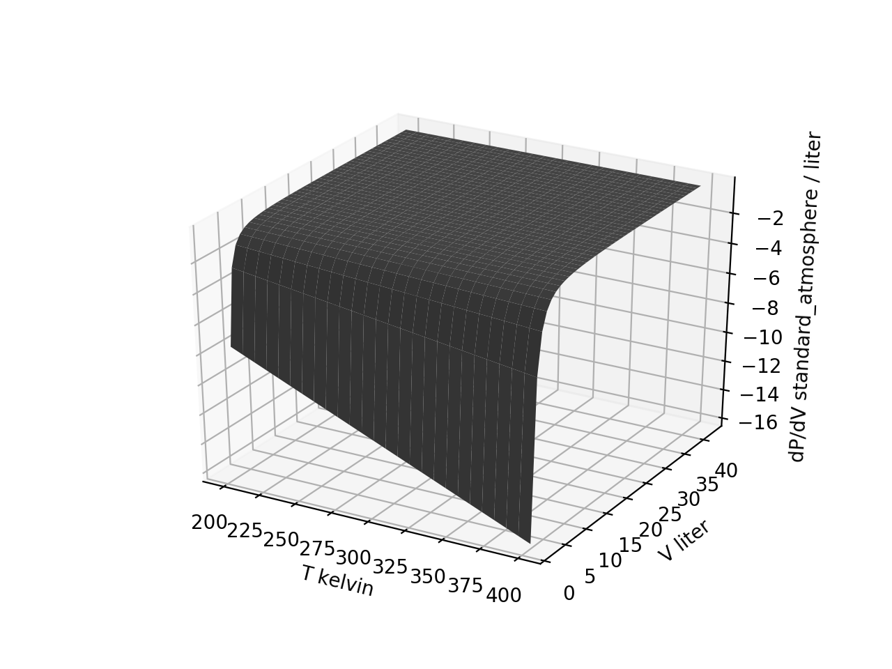
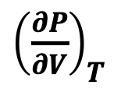

Next: ${\left(\frac{∂P}{∂V}\right)}_{T}$ of the entire $P\left(T,V\right)$ surface
${\left(\frac{∂P}{∂V}\right)}_{T}$
$$P\left(T,V\right)$$

Slide 5
Next: ${\left(\frac{∂P}{∂V}\right)}_{T}$ of the entire $P\left(T,V\right)$ surface
${\left(\frac{∂P}{∂V}\right)}_{T}$
$$P\left(T,V\right)$$

Slide 6
Next: ${\left(\frac{∂P}{∂V}\right)}_{T}$ of the entire $P\left(T,V\right)$ surface
${\left(\frac{∂P}{∂V}\right)}_{T}$
$$P\left(T,V\right)$$
Grids are shorter in the Volume direction

Slide 7
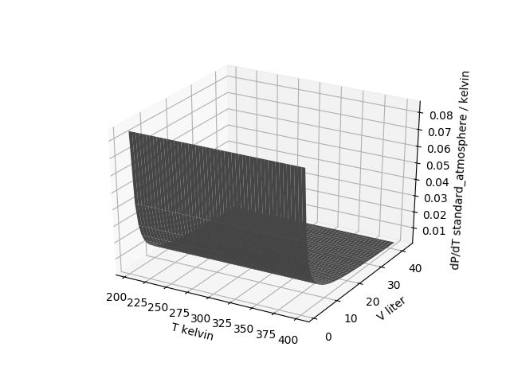
Next: ${\left(\frac{∂P}{∂T}\right)}_{V}$ of the entire $P\left(T,V\right)$ surface
$$P\left(T,V\right)$$
Grids are shorter in the Temperature direction

Slide 8
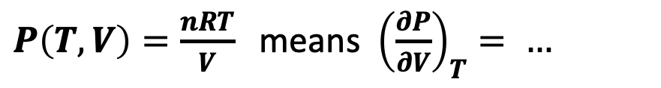
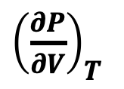

${\left(\frac{∂P}{∂V}\right)}_{T}$ of the entire $P\left(T,V\right)$ surface when you have an analytical representation of $P\left(T,V\right)$
$P\left(T,V\right)=\frac{nRT}{V}$ means ${\left(\frac{∂P}{∂V}\right)}_{T}= …$
${\left(\frac{∂P}{∂V}\right)}_{T}$
$$P\left(T,V\right)$$

Slide 9
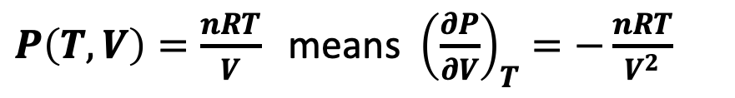
${\left(\frac{∂P}{∂V}\right)}_{T}$ of the entire $P\left(T,V\right)$ surface when you have an analytical representation of $P\left(T,V\right)$
$P\left(T,V\right)=\frac{nRT}{V}$ means ${\left(\frac{∂P}{∂V}\right)}_{T}=−\frac{nRT}{V^{2}}$
${\left(\frac{∂P}{∂V}\right)}_{T}$
$$P\left(T,V\right)$$
Grids are the same size
42 volumes
42 volumes

Slide 10
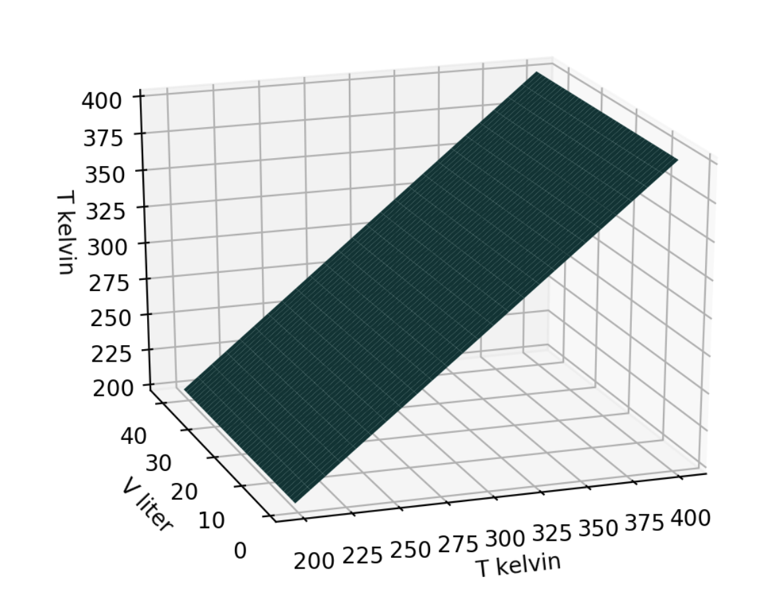
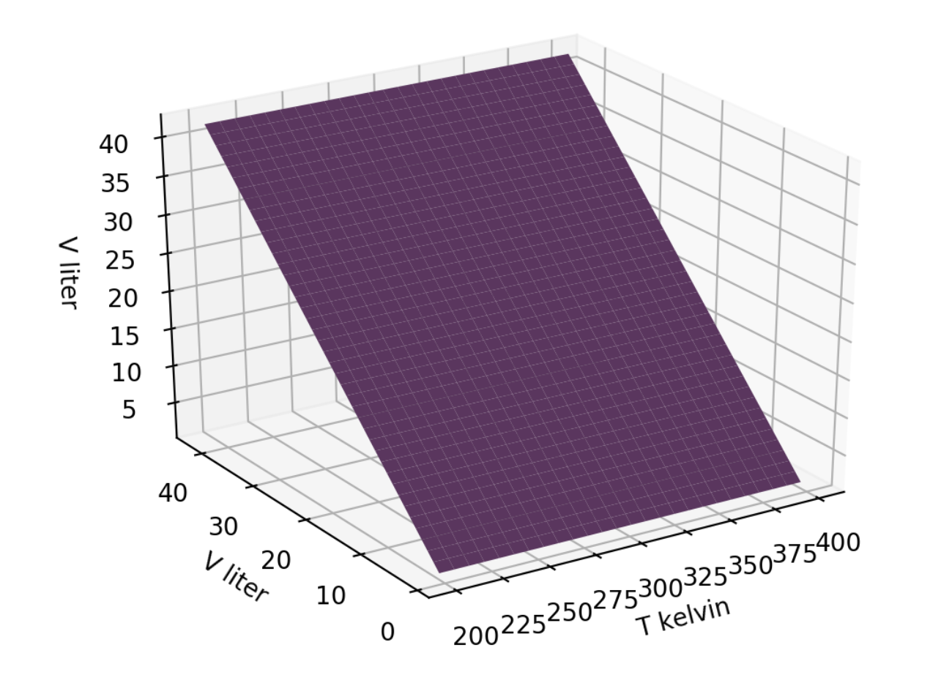


Visualizing state space
$$T\left(T,V\right)$$
$$V\left(T,V\right)$$

Slide 11
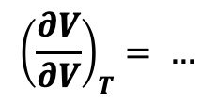
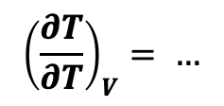
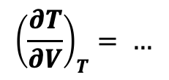
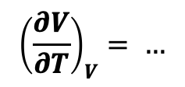
The “no-brainer” rules of partial derivatives
$$T\left(T,V\right)$$
$$V\left(T,V\right)$$
$${\left(\frac{∂T}{∂V}\right)}_{T}= …$$
$${\left(\frac{∂V}{∂V}\right)}_{T}= …$$
$${\left(\frac{∂T}{∂T}\right)}_{V}= …$$
$${\left(\frac{∂V}{∂T}\right)}_{V}= …$$

Slide 12
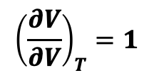
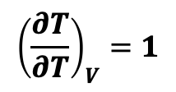
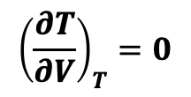
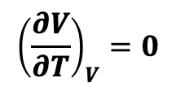
The “no-brainer” rules of partial derivatives
$$T\left(T,V\right)$$
$$V\left(T,V\right)$$
$${\left(\frac{∂T}{∂V}\right)}_{T}=0$$
$${\left(\frac{∂V}{∂V}\right)}_{T}=1$$
$${\left(\frac{∂T}{∂T}\right)}_{V}=1$$
$${\left(\frac{∂V}{∂T}\right)}_{V}=0$$

Slide 13
